Slide 1
21.01.2025
Pascal

Slide 2
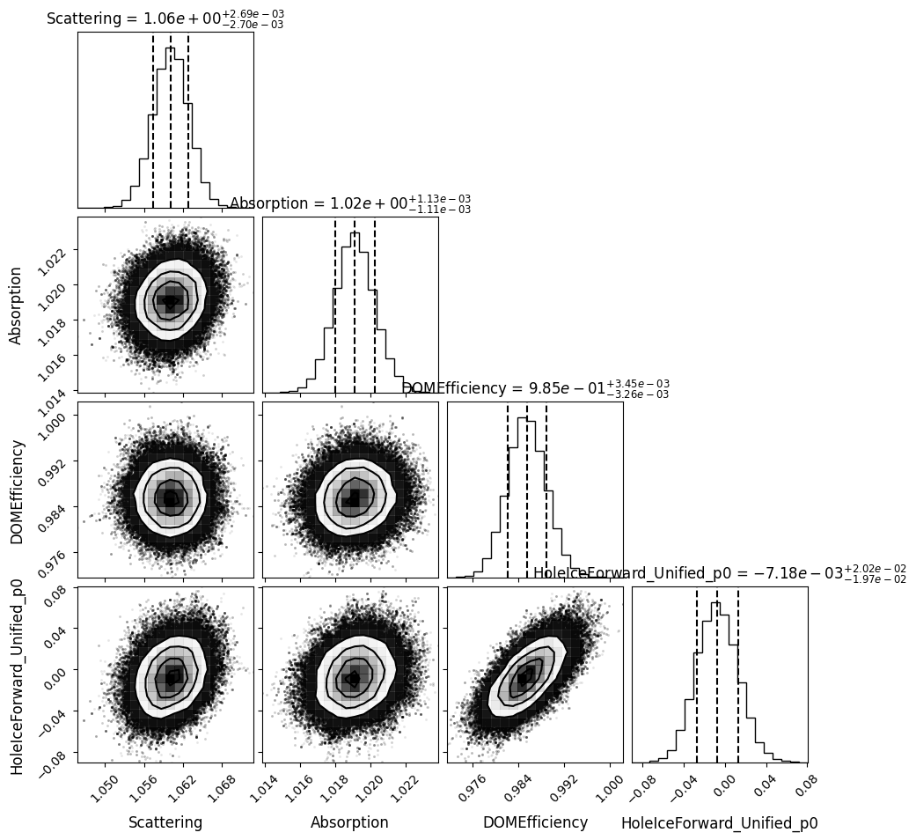
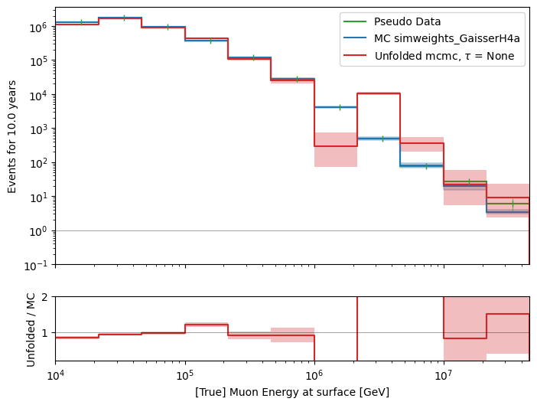
Unfold event rate, 4 systematics, MCMC
X0 = [True values, 1, 1, 1, 0.2]
n_used_steps = 1000
n_walkers = 500
n_burn_steps = 1000

Slide 3
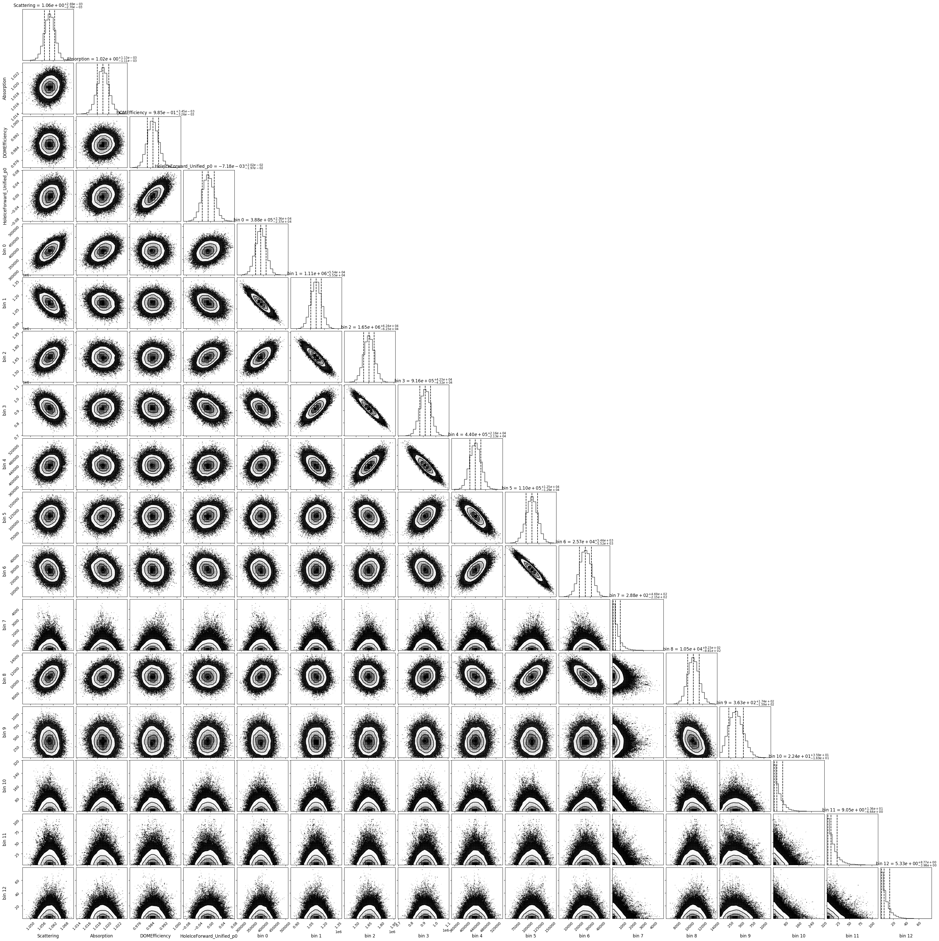

Slide 4
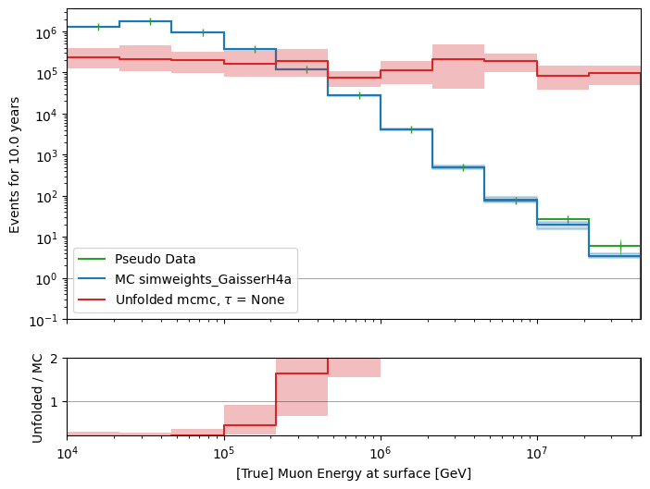
Unfold event rate, 4 systematics, MCMC
X0 = [1e5,., 1, 1, 1, 0.2]
n_used_steps = 1000
n_walkers = 500
n_burn_steps = 1000

Slide 5
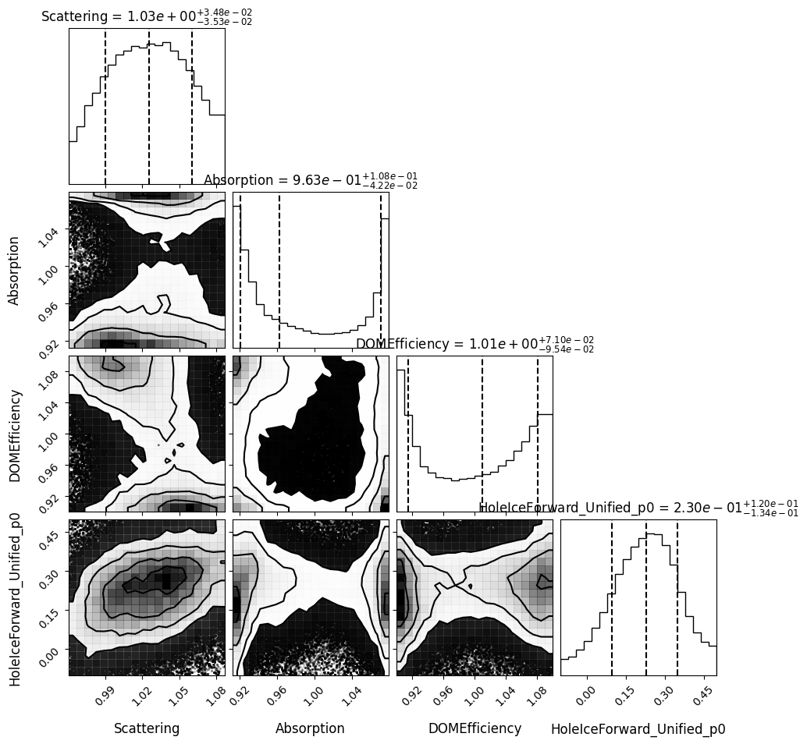
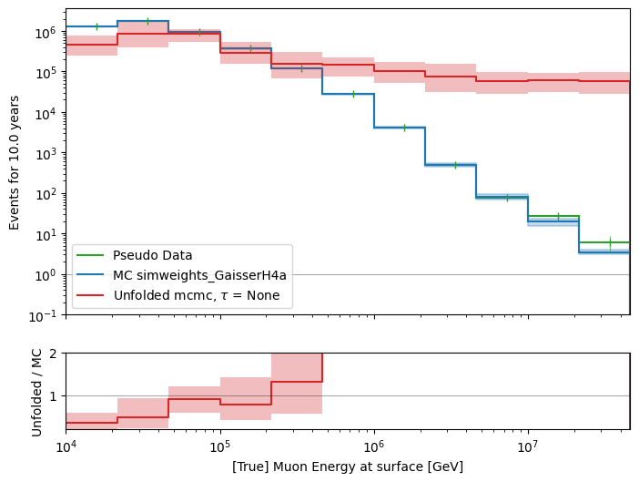
Unfold event rate, 4 systematics, MCMC
X0 = [1e5,., 1, 1, 1, 0.2]
n_used_steps = 2000
n_walkers = 700
n_burn_steps = 2000

Slide 6
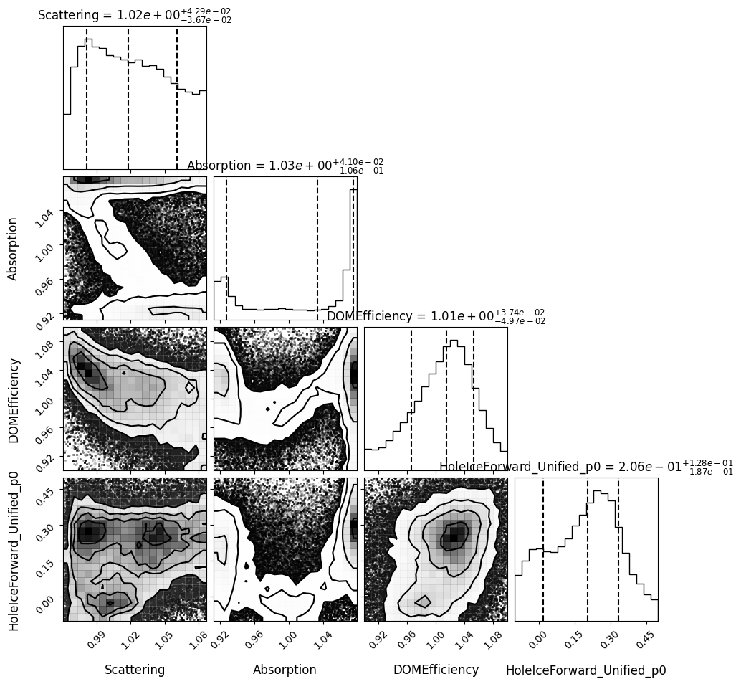
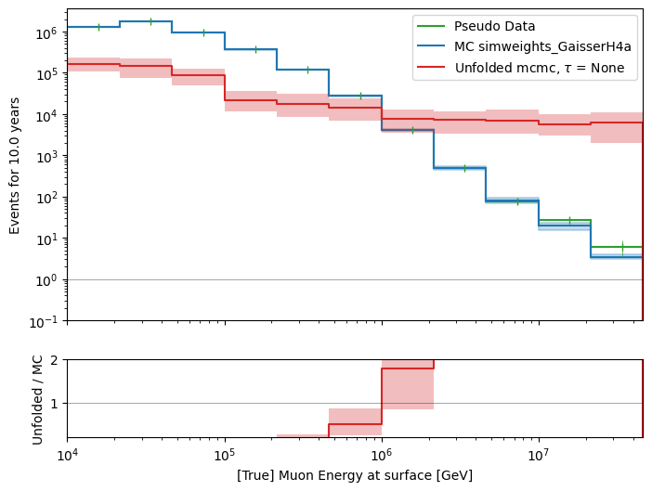
Unfold event rate, 4 systematics, MCMC
X0 = [True values * 0.1, 1, 1, 1, 0.2]
n_used_steps = 1000
n_walkers = 500
n_burn_steps = 1000

Slide 7
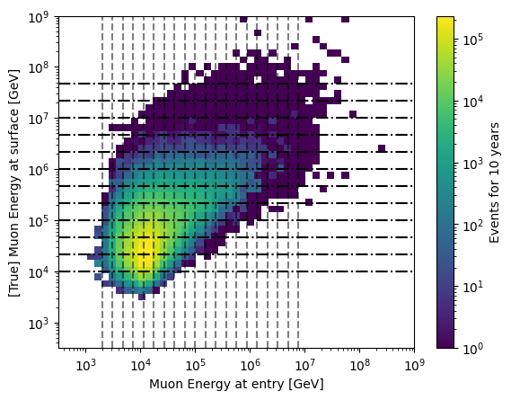
Unfold muon event rate
No systematics, just for baseline check

Slide 8
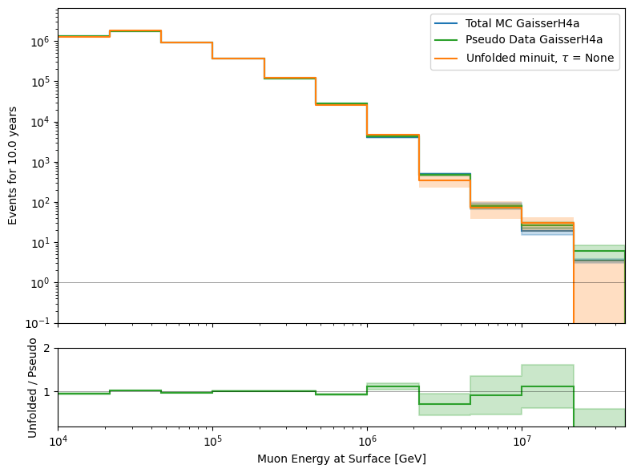
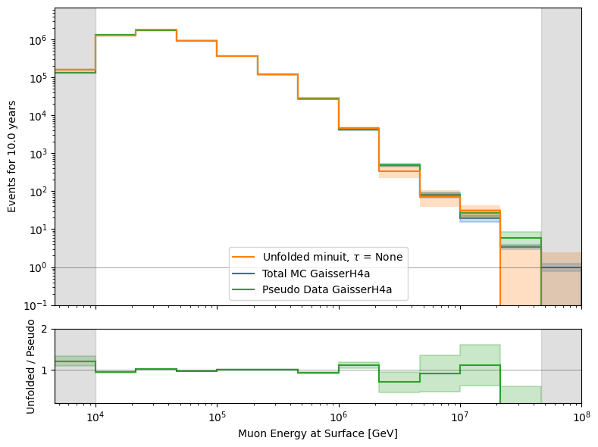

Slide 9
Unfold muon flux

Slide 10
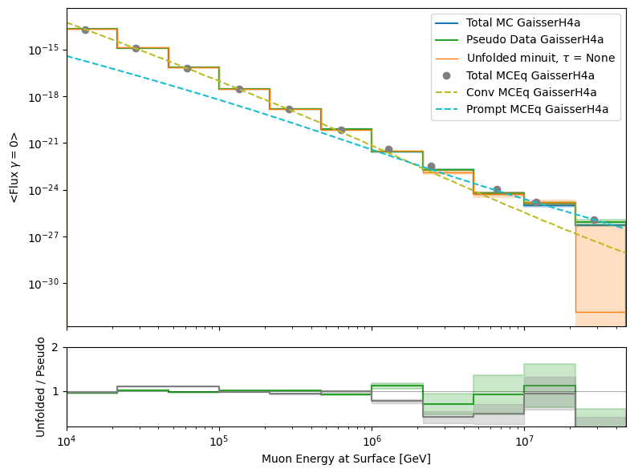
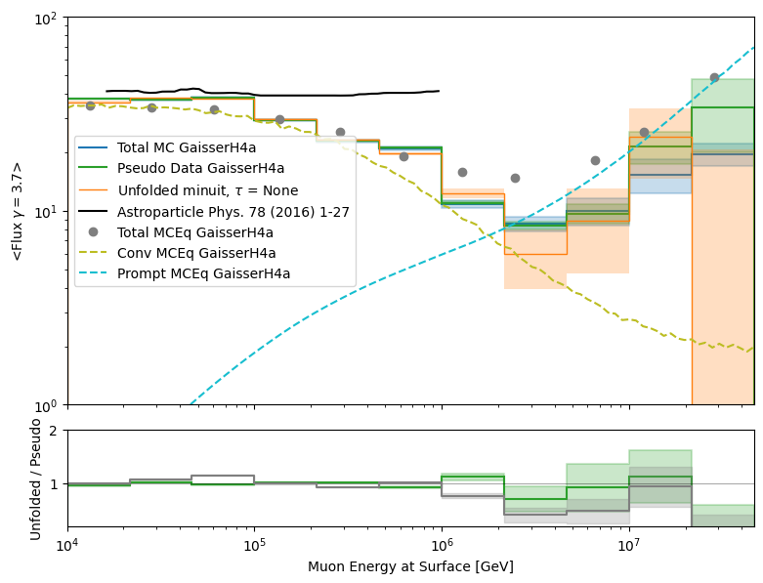
No systematics
10 years livetime
No initial start values
No bounds
No regularization

Slide 11
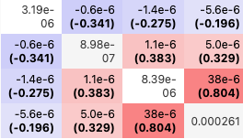
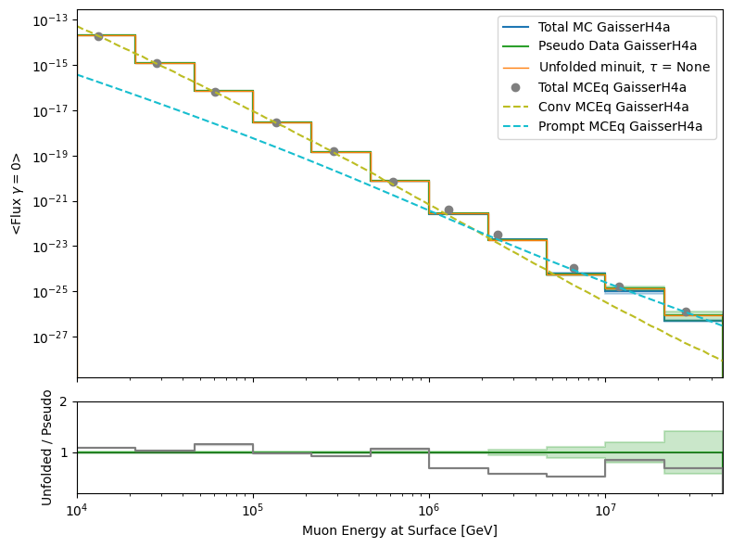
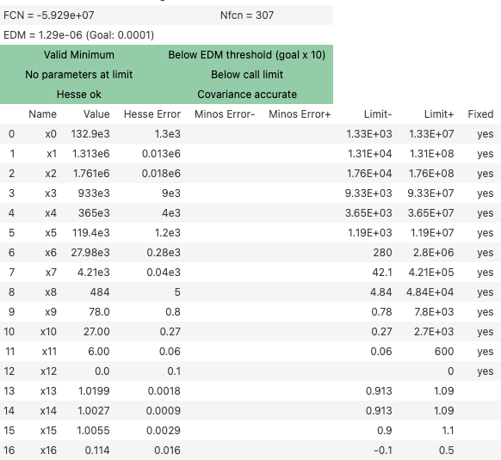
Test true input, fix bins, fit 4 systematics
X0 = [True values , 1, 1, 1, 0.2], bounds * 100

Slide 12
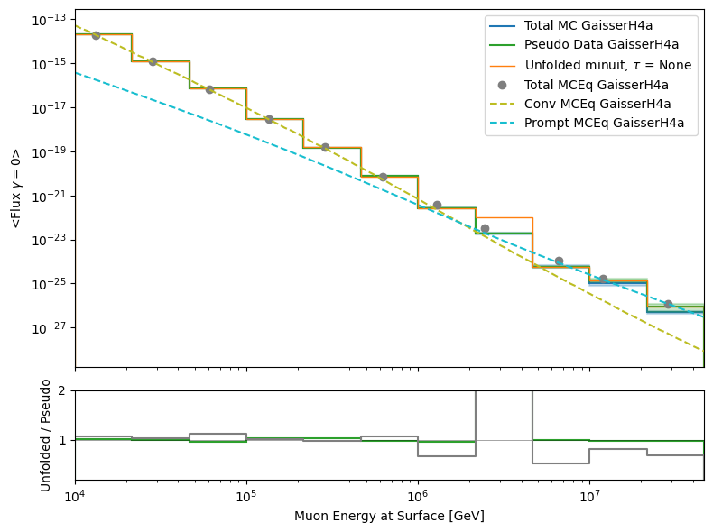
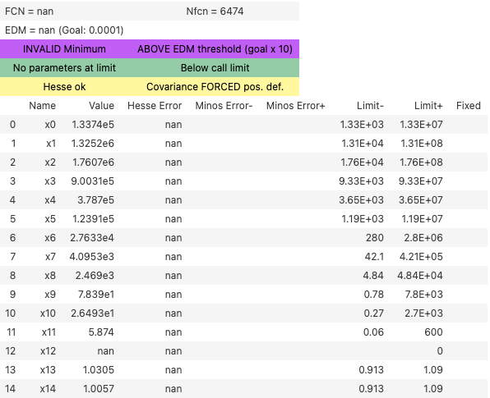
Scattering & Absorption
X0 = [True values , 1, 1], bounds * 100

Slide 13
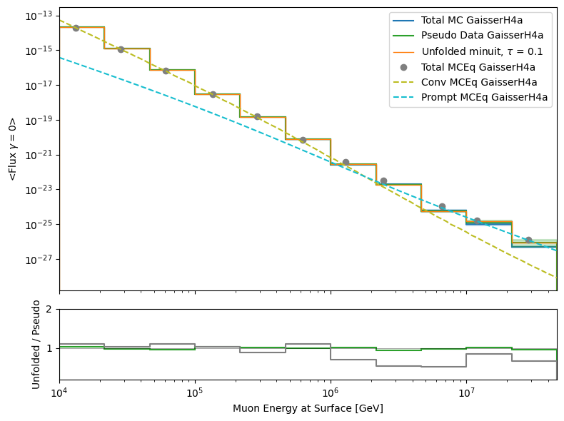

Scattering & Absorption: tau = 0.1
X0 = [True values , 1, 1], bounds * 100

Slide 14
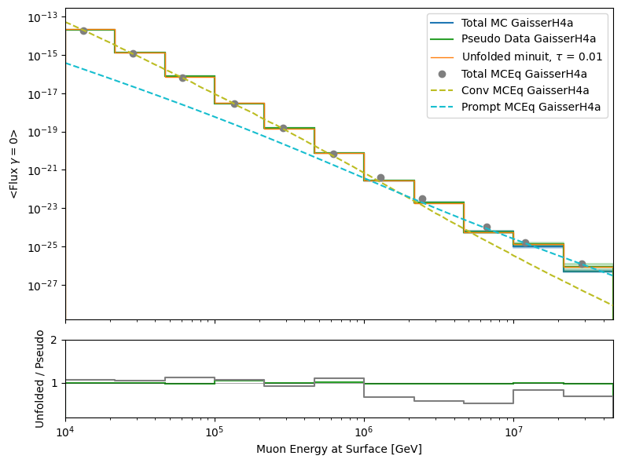
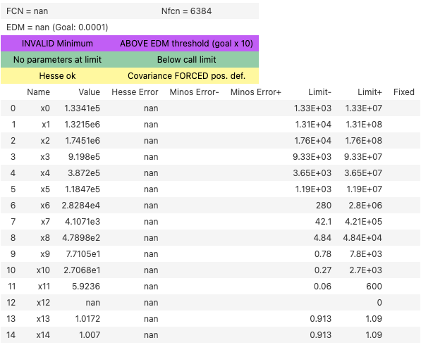
Scattering & Absorption: tau = 0.01
X0 = [True values , 1, 1], bounds * 100

Slide 15
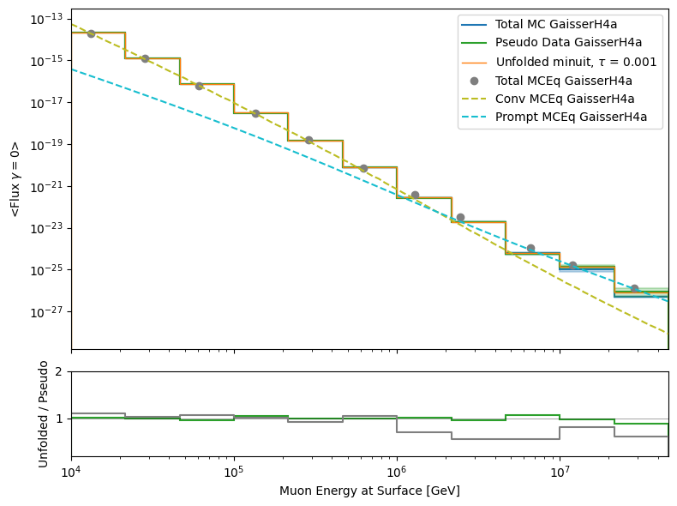

Scattering & Absorption: tau = 0.001
X0 = [True values , 1, 1], bounds * 100

Slide 16
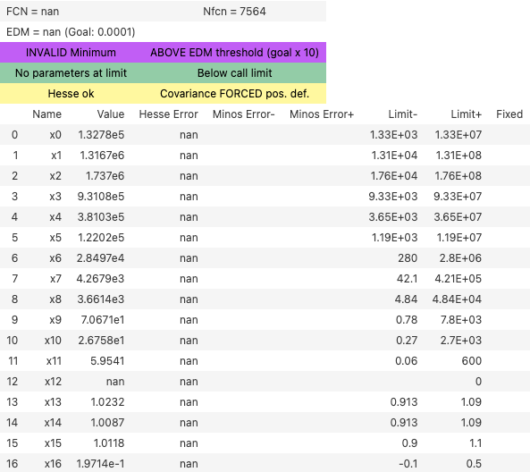
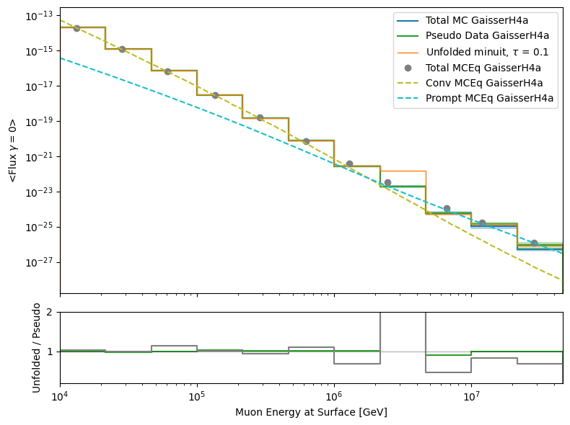
4 systematics: tau = 0.1
X0 = [True values , 1, 1, 1, 0.2], bounds * 100

Slide 17
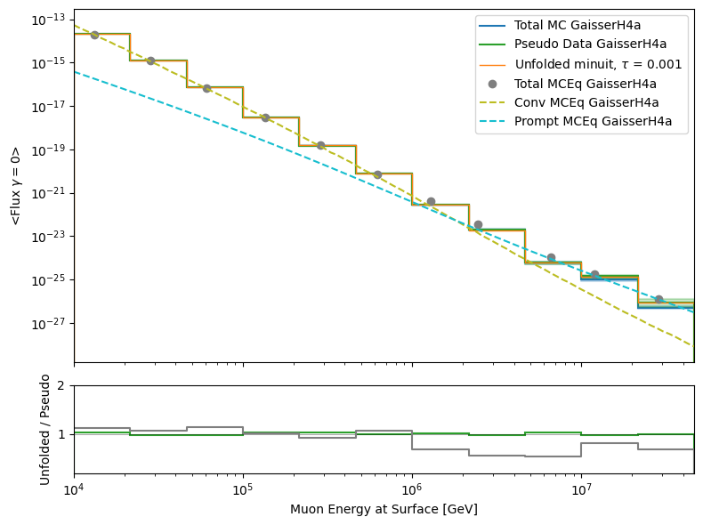
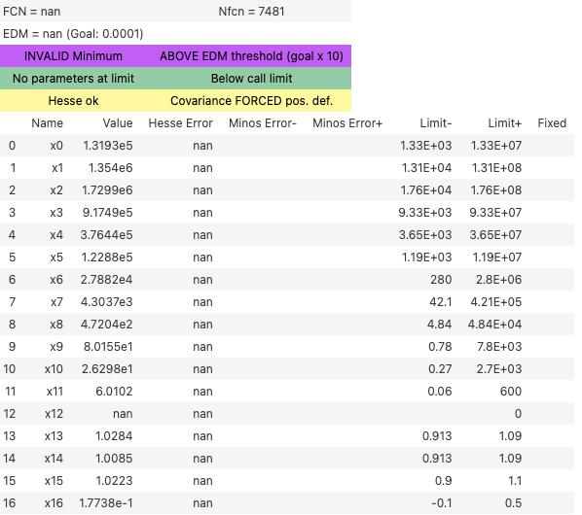
4 systematics: tau = 0.001
X0 = [True values , 1, 1, 1, 0.2], bounds * 100

Slide 18
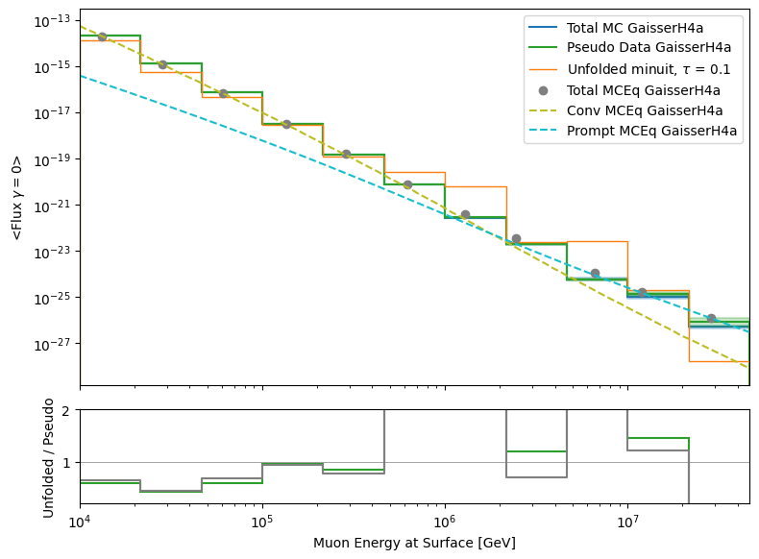
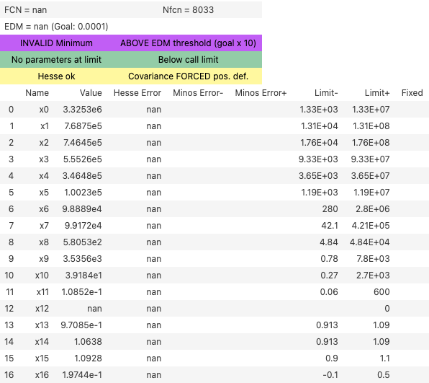
4 systematics: tau = 0.1
X0 = [1e5, …, 1, 1, 1, 0.2], bounds * 100

Slide 19
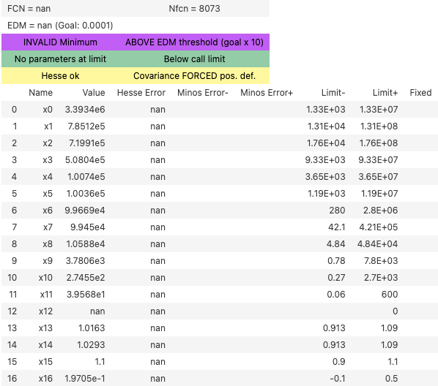
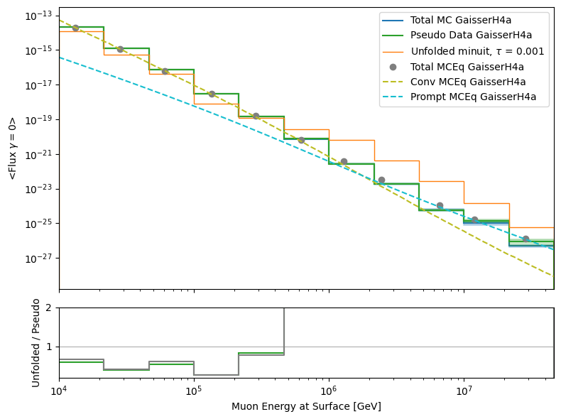
4 systematics: tau = 0.001
X0 = [1e5, …, 1, 1, 1, 0.2], bounds * 100

Slide 20

Remove last unfolding bin

Slide 21
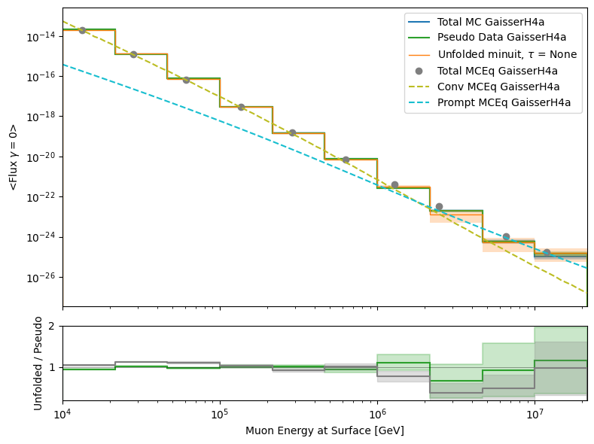
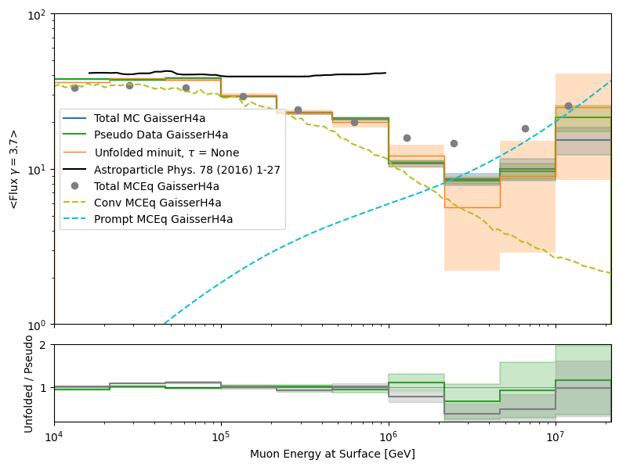
No systematics
10 years livetime
No initial start values
No bounds
No regularization

Slide 22
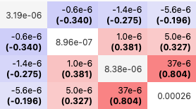
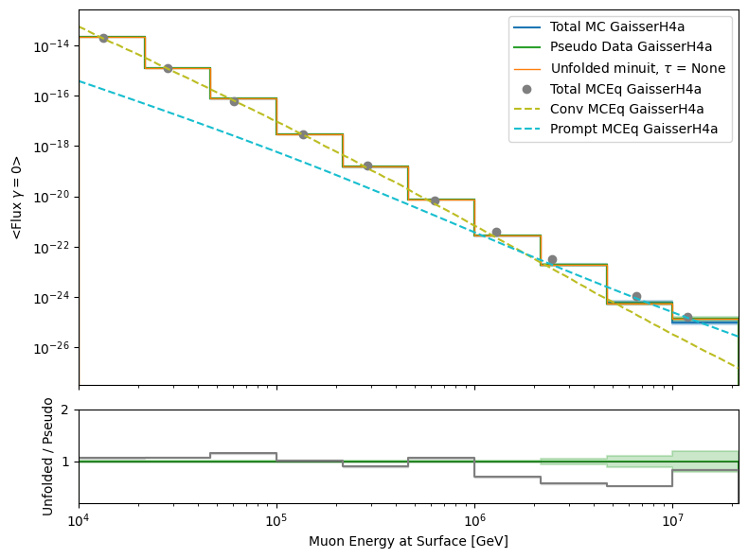
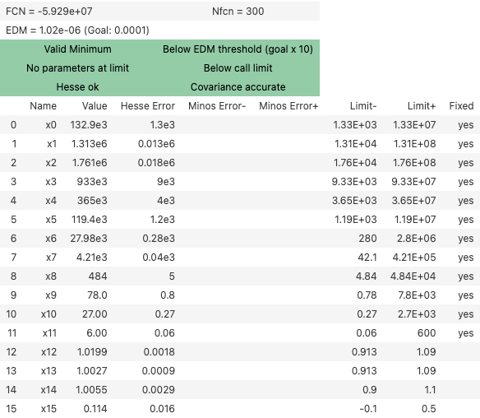
Test true input, fix bins, fit 4 systematics
X0 = [True values , 1, 1, 1, 0.2], bounds * 100

Slide 23
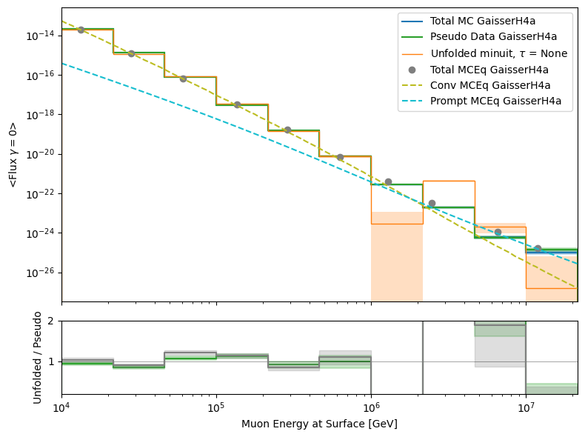
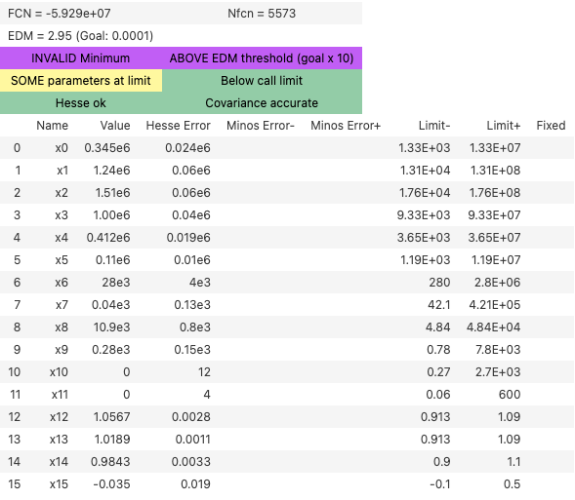
4 systematics: tau = None
X0 = [True values , 1, 1, 1, 0.2], bounds * 100

Slide 24
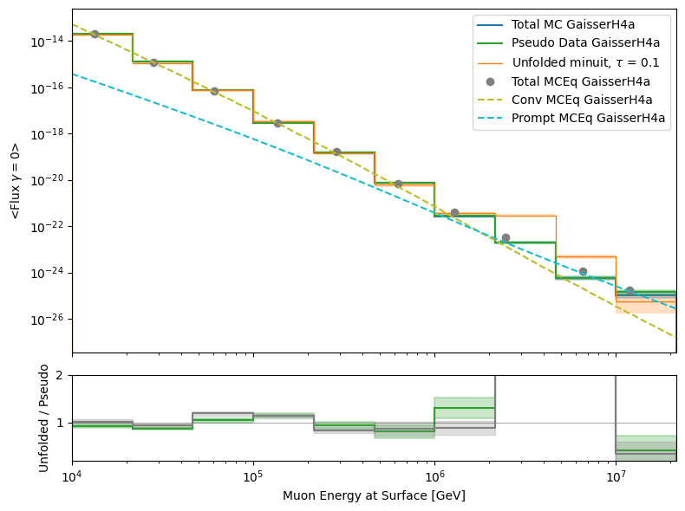

4 systematics: tau = 0.1
X0 = [True values , 1, 1, 1, 0.2], bounds * 100

Slide 25
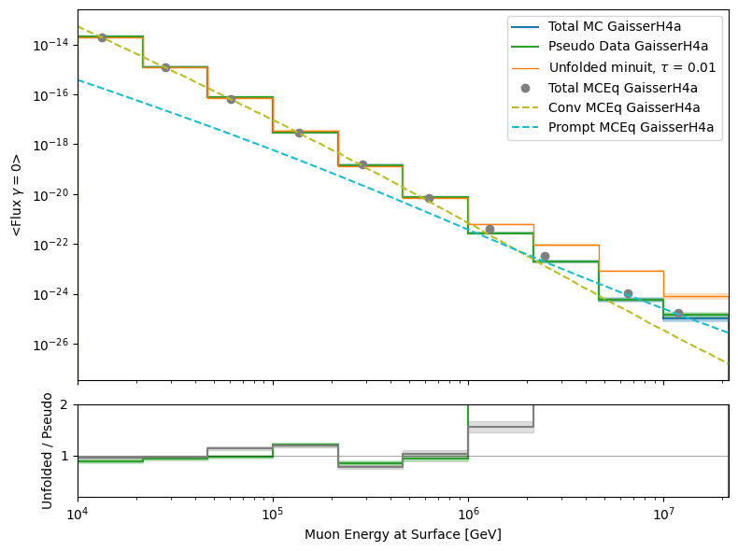
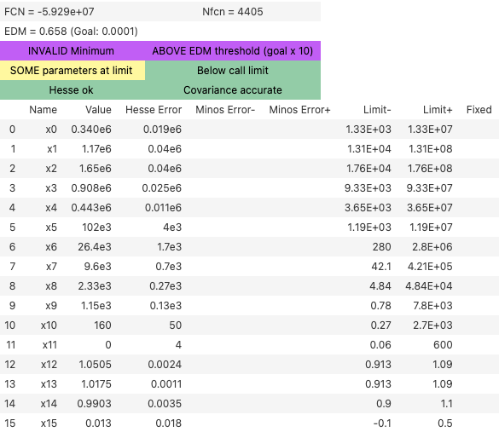
4 systematics: tau = 0.01
X0 = [True values , 1, 1, 1, 0.2], bounds * 100

Slide 26
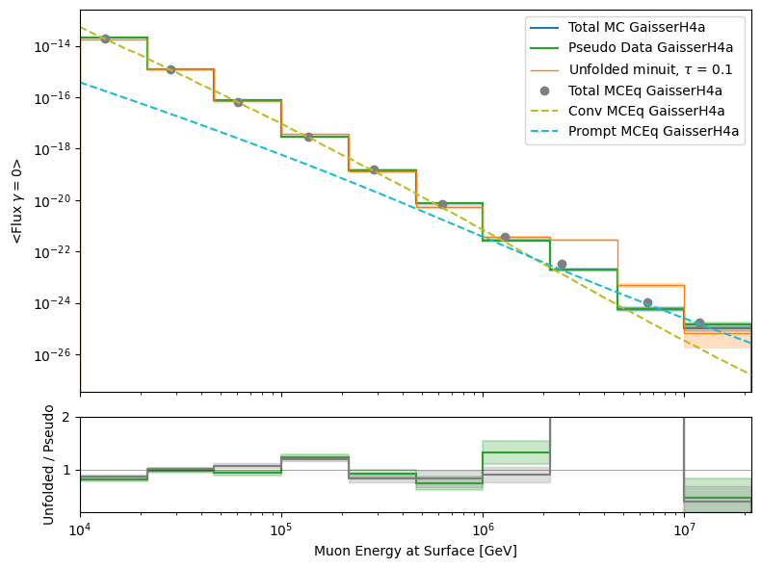
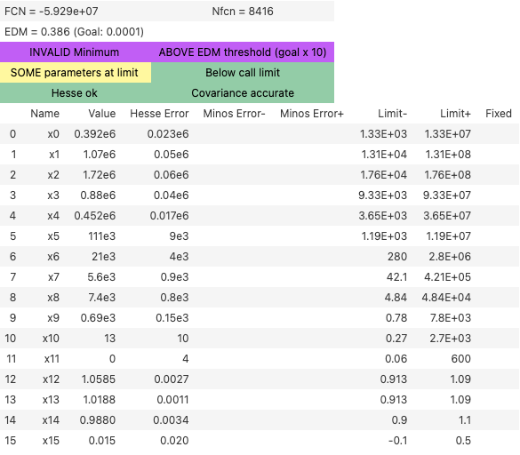
4 systematics: tau = 0.1
X0 = [1e5, …, 1, 1, 1, 0.2], bounds * 100

Slide 27
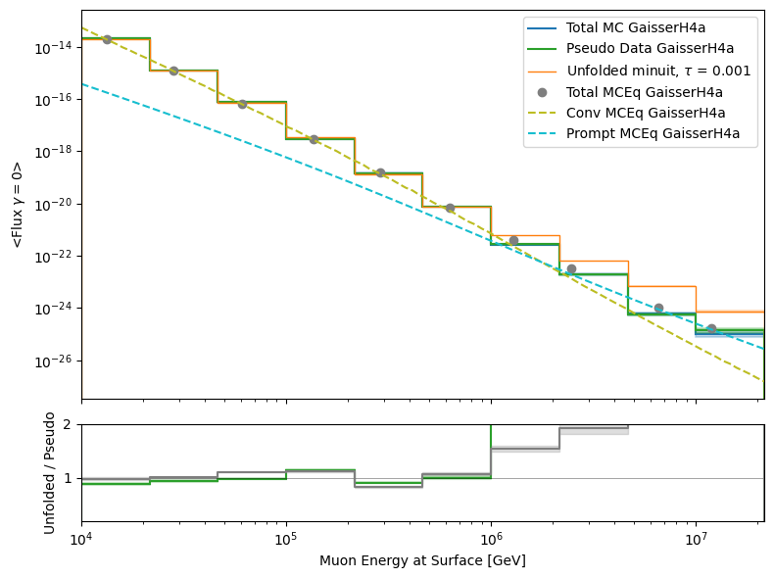
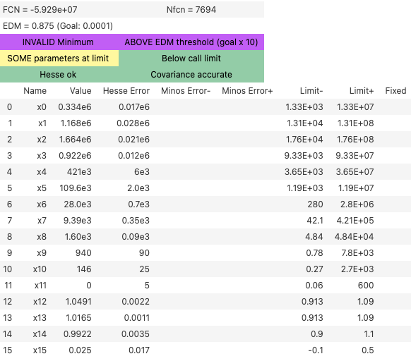
4 systematics: tau = 0.001
X0 = [True values * 1.5, 1, 1, 1, 0.2], bounds * 100

Slide 28

Remove last proxy bin

Slide 29
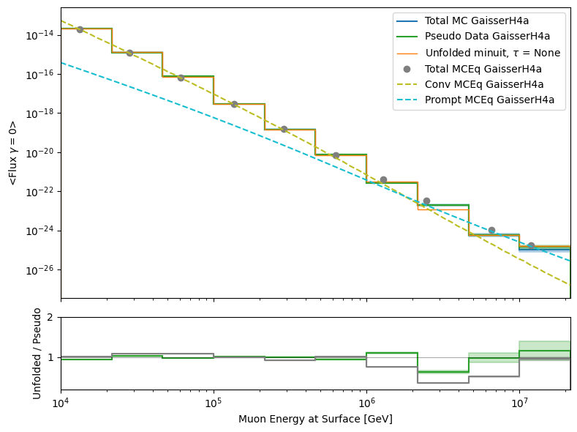
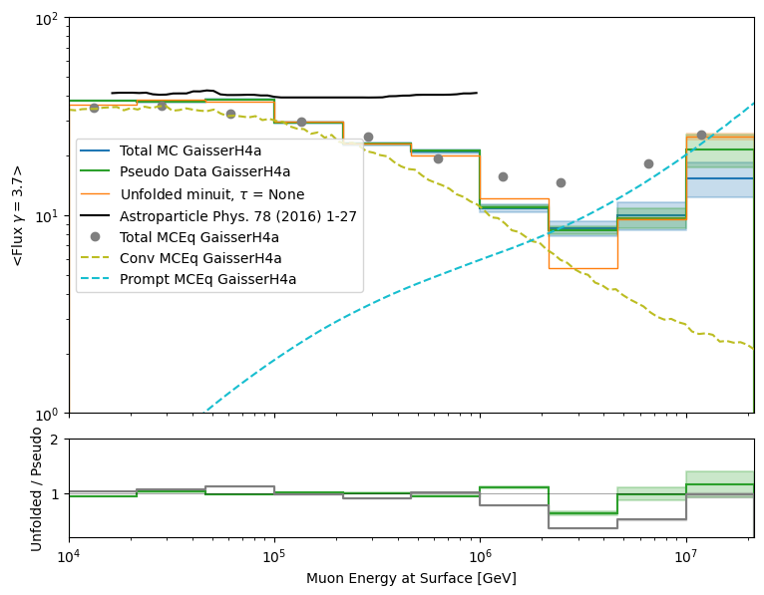
No systematics
10 years livetime
No initial start values
No bounds
No regularization

Slide 30
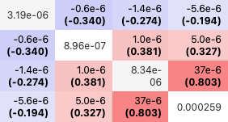
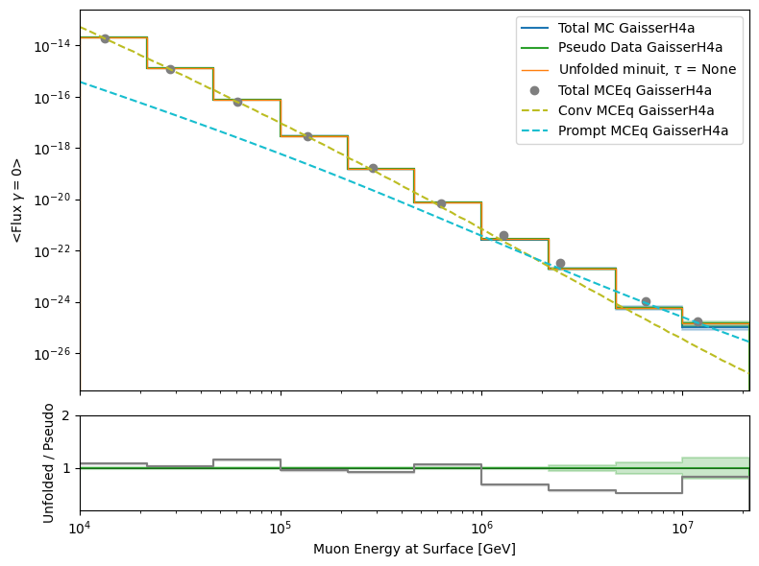
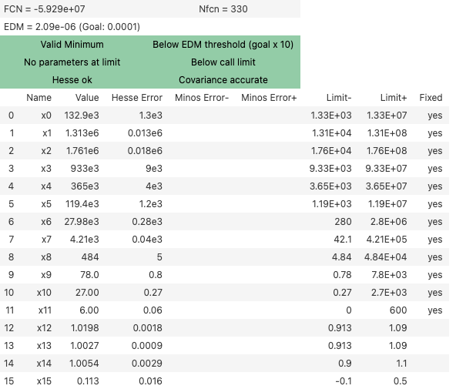
Test true input, fix bins, fit 4 systematics
X0 = [True values , 1, 1, 1, 0.2], bounds * 100

Slide 31
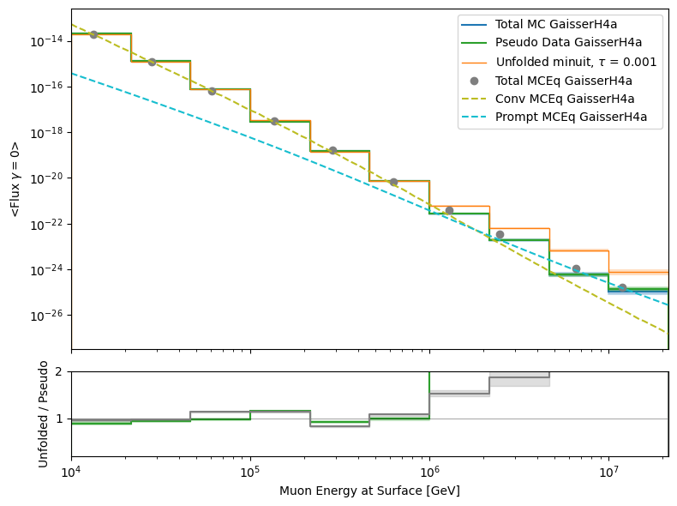

4 systematics: tau = 0.001
X0 = [True values , 1, 1, 1, 0.2], bounds * 100

Slide 32


4 systematics: tau = 0.0001
X0 = [True values , 1, 1, 1, 0.2], bounds * 100

Slide 33


4 systematics: tau = 0.0001
X0 = [1e5, … , 1, 1, 1, 0.2], bounds * 100

Slide 34


Unfold until 1 PeV

Slide 35


No systematics
10 years livetime
No initial start values
No bounds
No regularization

Slide 36



Test true input, fix bins, fit 4 systematics
X0 = [True values , 1, 1, 1, 0.2], bounds * 100

Slide 37


4 systematics: tau = 0.01
X0 = [1e5, … , 1, 1, 1, 0.2], bounds * 100

Slide 38


Remove last two proxy bins

Slide 39


No systematics
10 years livetime
No initial start values
No bounds
No regularization

Slide 40


4 systematics: tau = None
X0 = [True values , 1, 1, 1, 0.2], bounds * 100

Slide 41


4 systematics: tau = 0.001
X0 = [1e5, … , 1, 1, 1, 0.2], bounds * 100

